Slide 1


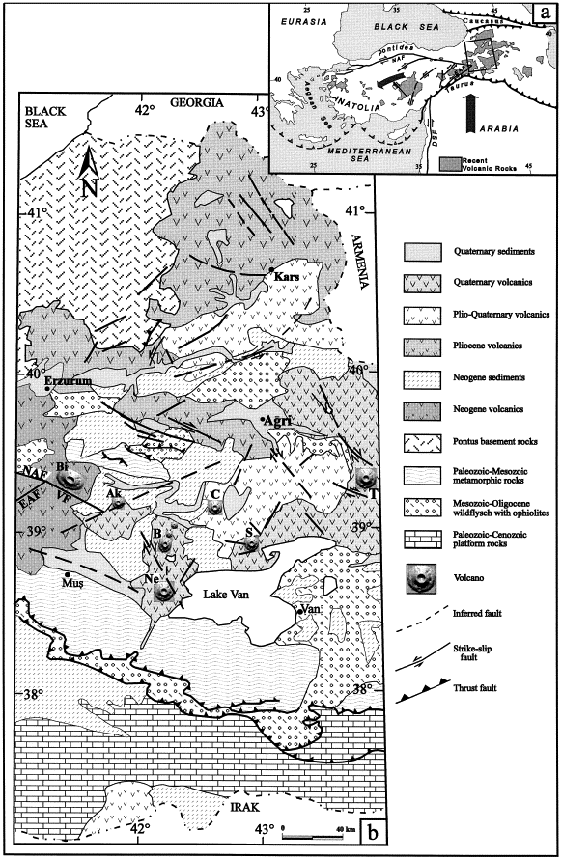
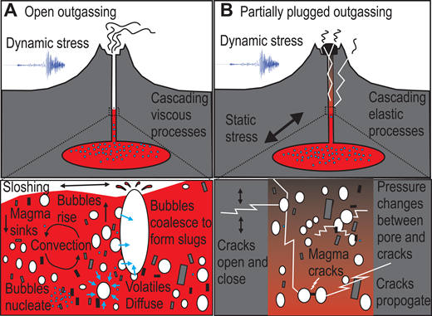
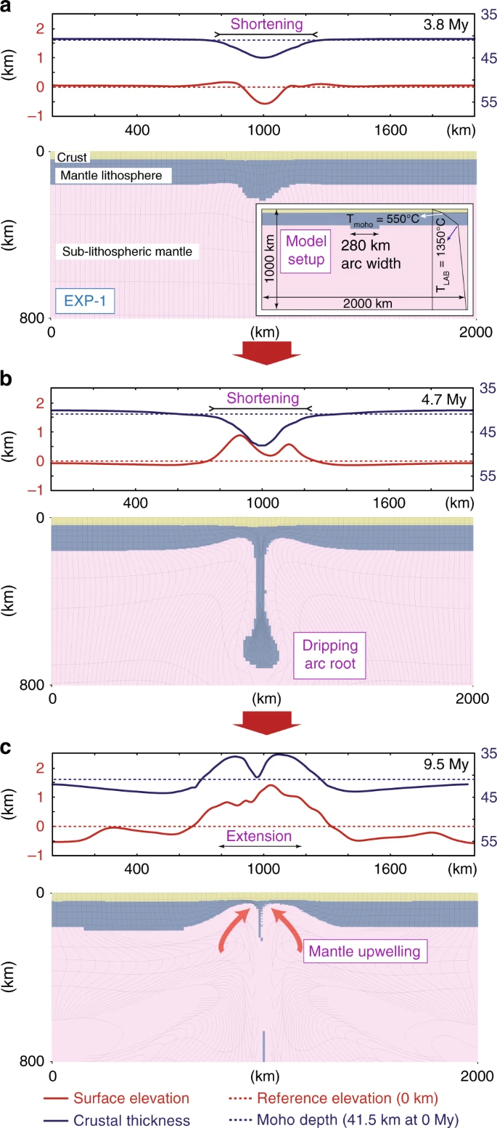
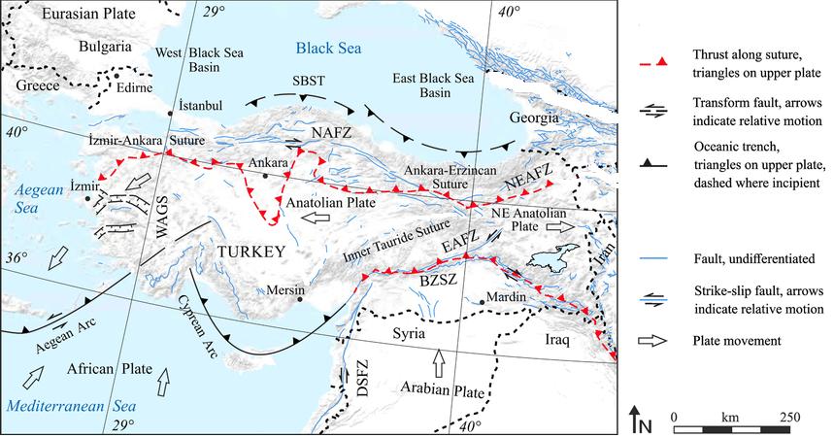
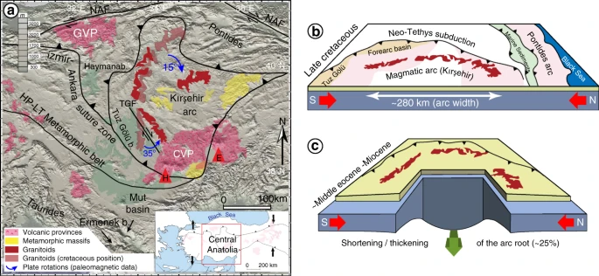
Effects of Fault Zone and Uplift on Earthquakes and Volcanism in Central and East Anatolia Region
Earth Sciences Department
Reshma Giji , Nash Hebert
Abstract:
The relationship between earthquakes and volcanoes is an important topic of study, as it is known that earthquakes can cause volcanism, but the underlying mechanisms are not fully understood. The association between earthquakes and volcanoes in Turkey, specifically in the East Anatolian Fault Zone and Central Anatolia region, is the main topic of this study. Due of the area's high earthquake frequency and abundance of volcanoes, it was chosen. Although it is obvious that earthquakes can cause volcanic eruptions, the connection between the two is not simple because many different factors affect volcanism. Drip tectonics, which affects the region's volcanism, is one of these variables. The Central Anatolian plateau's notable uplift is another element that further exacerbates the interaction between earthquakes and volcanoes. Despite these difficulties, when active volcanoes are found within 50 km of significant fault zones, a strong correlation between earthquakes and volcanoes can be seen. In certain situations, the fault zones' effects on tectonic deformation may let magma get through and possibly spark volcanic activity.
Volcanic eruptions may also be brought on by the growth of leaky arc roots, which may be caused by tectonic processes that cause lithospheric instability. More in-depth investigation is required to fully comprehend the mechanisms underlying the connection between earthquakes and volcanoes. More thorough integration of geological and geophysical techniques may aid in better understanding these complex processes and even aid in future prediction of their occurrence.
Evidence for Earthquakes trigger volcanoes:
1
There are numerous instances where earthquakes cause volcanic eruptions. For instance, the Puyehue-Cordon Caulle volcanic complex experienced many eruptions in Chile following the 1960 Chilean earthquake (M9.5). A magnitude 7.8 earthquake in the Philippines also caused Mount Pinatubo to erupt in 1991. Similar to this, Mount Erciyes, a nearby dormant volcano, experienced an upsurge in seismic activity after the 1999 Izmit earthquake in Turkey. Numerous studies have discovered proof that tectonic activity might contribute to the eruption of volcanic material. For instance, a study of the eruption of the Miyakejima volcano in Japan in 2000 indicated that tectonic activity-related enhanced seismicity and ground deformation occurred prior to the eruption. Another investigation into the Mount Pinatubo explosion in 1991 discovered that tectonic activity contributed to the eruption by creating new routes for magma to travel to the surface. With regard to Mount Ararat, there is proof of tectonic activity in the area, with the Anatolian Fault being the cause of many significant earthquakes in the region. There is some evidence to suggest that tectonic activity may play a part in setting off volcanic eruptions at Mount Ararat, even if the relationship between tectonic activity and volcanic activity in the area is complicated.
3
Through a number of mechanisms, earthquakes can cause volcanic activity. In open system lava lakes, processes include volatile diffusion, bubble nucleation, coalescence, rise, shaking free of bubbles clinging to individual crystals, and sloshing can result in enhanced rates of convection and degassing. However, due to reduced degassing after intense shaking, which can raise the possibility of pressure build-up inside the volcano, closed system volcanoes are more likely to experience eruptions brought on by earthquakes.In addition, the tension from an earthquake may cause a magma fracture to close, plugging a volcano and reducing degassing. In reaction to both dynamic and static forces, cracks can widen and narrow. Data suggests that permeability may decrease in a dynamic scenario where fluid within holes and cracks redistributes and drives changes in these structures' permeability. This is in contrast to findings that show increased permeability in hydrological systems after earthquakes and theories that hydraulic surges may be what causes fracture spread in volcanoes. One explanation for this might be earthquake-triggered ductile compaction, which lowers permeability in changed country rock and magmas.
Background:
The collision between the Arabian and Eurasian Plates, which started roughly 70 million years ago and is still continuing on today, has shaped the geological history of the Anatolian region. The Anatolian Fault, a significant fault zone in Turkey that has been the cause of numerous earthquakes over the past few decades, notably the 1999 Izmit and Duzce earthquakes, was created as a result of this collision. Although previous research has hinted at a possible connection between tectonic activity and volcanic eruptions in the area, the underlying mechanisms are still not completely understood. Both the dormant stratovolcanoes in Turkey, Mount Ararat and Mount Erciyes, are situated in tectonically active areas. In the Eastern Anatolian region, the spatiotemporal evolution of hypocenters has revealed a systematic migration of micro and moderate-sized earthquakes from the main fault to adjacent fault segments within a few days, indicating increased interaction between the major branch of the East Anatolian Fault Zone (EAFZ) and its secondary structures.Instead of being a continuous fault plane, the EAFZ is made up of numerous separate strands with localized pull-apart basins and push-up zones. Eastern Turkey has seen earthquakes with magnitudes greater than 7 as a result of the fault moving.
The North Anatolian Fault Zone (NAFZ) has experienced a series of westward migrating M7 earthquakes that have activated nearly the whole NAFZ, but the East Anatolian Fault Zone (EAFZ) has only produced one significant earthquake during the past century. Seismic activity in the area shows an active bond with a width of roughly 20 km and generally follows the EAFZ's northeast to southwest trend. The hypocenter distribution indicates that there are a number of smaller, East-West and North-South oriented sub-segments inside the EAFZ. The observed seismic activity patterns indicate that earthquakes on the main fault interact with surrounding fault segments, perhaps causing seismic events on nearby splay faults. Omori-Utsu law provides a clear description of the temporal evolution of aftershock activities along the fault zone. Our research makes use of a variety of geophysical techniques to better understand the connection between tectonic movement along the Anatolian Fault and volcanic activity in the area. These techniques include analyzing magnetic surveys to find patterns of tectonic activity along the fault, collecting information on the history and characteristics of previous eruptions, and analyzing the chemical and mineral composition of volcanic rocks. Our study aims to improve knowledge of the geological processes that fuel volcanic activity in the area.
2
4
The key to understanding earthquake to volcano interactions is centered around the response of gas and magma to earthquake imposed stresses. When exposed to strong seismic shaking, volcanoes with open lava lakes will release more gas, and volcanoes that are partially plugged will release less gas. Only about 0.3-0.4% of volcanic eruptions are triggered by earthquakes, but this is dependent on the location, as in areas like Chile and Indonesia, 25% of eruptions are triggered by earthquakes. This shows that some volcanoes are more sensitive to earthquakes than others are, and location matters. Open low-viscosity lava lakes that have gas bubbles could have a viscous response related to bubble outgassing, while a high viscosity partially closed lava dome will have a more elastic response due to cracks open and closing that has an effect on gas flow. Remote sensing shows that more than 50% of 5 or greater kPa shaking events at volcanoes researched drive a significant change in degassing. In open system volcanoes where lava lakes have direct access to the atmosphere, after an earthquake the output of SO2 will be higher.
Relationships between volcanic patterns and neotectonics in Eastern Anatolia from analysis of satellite images and DEM brings forth the relationship between neotectonics (recent geological activity) and the distribution volcanic activity in Eastern Anatolia. The authors evaluate the local volcanic patterns and look for potential eruption triggers using satellite imagery and digital elevation models (DEM). In Eastern Anatolia, active volcanoes are situated 50 km or less from significant fault zones, which are frequently linked to earthquake activity. There may be a causal connection between earthquakes and volcanoes based on their spatial correlation. They have discovered that the late Neogene volcanism in Eastern Anatolia is connected to a horizontal, about 908N-trending trend. There may have been an extensional or strike-slip strain in the area. Tectonic deformation has produced open structures within the Earth's crust, which make up the majority of the open structures giving way to magma. These open up channels for magma to travel through and start a volcanic eruption. A few years after significant earthquakes, some of the largest volcanic eruptions in the area (like Mount Nemrut) took place, which could indicate that the earthquakes may have caused the volcanic activity. As a result of an earthquake, pressure, temperature, and other variables may vary, which may modify how magma behaves beneath the earth's surface. Mechanisms for tectonic deformation-induced direct magma injection into the volcanic plumbing system, (b) changes in hydrothermal activity as a result of altered fluid pathways brought on by seismic activity, and (c) stress changes in the crust that may affect the stability of magma chambers and cause eruptions. (Adıyaman et al., 1998)
Figure 2
Goals:
It is unclear how the East Anatolian Fault line's earthquakes and volcanic activity are related to one another. Our study's objective is to determine how the East Anatolian Fault's tectonic activity may cause or affect the area's volcanic activity. The influence of these seismic occurrences on volcanoes like the Nemrut Caldera, Mount Ararat, and Mount Erciyes remains unknown, despite the fact that this fault zone is frequently the source of earthquakes. We seek to better understand the intricate geological mechanisms underpinning volcanic activity in the area by examining geological data, seismic activity, and volcanic history. Our study will help to advance knowledge of the interaction between tectonic movement and volcanic activity in this region.
Figure 3
5
Drip Tectonics relationship with Earthquakes
Geodynamics models show seismic data in Central Anatolia that reveals missing lithosphere and remnants of structure that are characteristic of dripping arc root, along with mysterious greater than 1 km uplift that happens along the whole plateau. Drip tectonics may be the reason for this uplift over the plateau and volcanism that is seen there. The models further show that the removal of arc root yields initial surface subsidence that upturns more than 1 km of uplift as the vertical loading along with the crustal deformation changes during the drip evolution.
Tectonic Setting:
The East Anatolian Fault is one of the prominent geological features that define the region of Turkey. Two notable volcanoes, Mount Ararat, which is located close to the Turkey-Armenia border, and Mount Erciyes, which is situated in central Turkey close to the city of Kayseri, are connected to this fault zone. These features are highlighted on a map of the area, which also displays the Anatolian Fault and related plate movements.
Discussion:
In the context of Central Anatolia and Eastern Anatolia, we see the connection between earthquakes and volcanic activity. Earthquakes can change the pressure and temperature beneath the earth's surface, which can change how magma behaves below the surface. According to the findings, tectonic processes including plate shortening and oroclinal folding can lead to lithospheric instability, which can result in the growth of leaking arc roots that can spark volcanic activity. Another research emphasizes how crucial a part gas and magma play in the connection between volcanoes and earthquakes. The openness of the lava lakes determines how a volcano reacts to seismic disturbance; open systems release more gas than partially plugged systems. Although it is rare, the proportion of volcanic eruptions brought on by earthquakes varies depending on where the volcano is located. Up to 25% of volcanic eruptions are sparked by earthquakes in places like Chile and Indonesia. Drip tectonics may be to blame for the uplift and volcanism that have been observed in the region, according to research on geodynamic models in Central Anatolia. The initial surface subsidence caused by arc root removal is followed by more than 1 km of uplift throughout drip evolution. One of the studies used satellite data and digital elevation models (DEM) to assess the regional volcanic patterns and possible eruption triggers in Eastern Anatolia. The research discovered that large fault zones, which are typically connected to earthquake activity, are located 50 km or less from active volcanoes. Additionally, the research discovered a link between the late Neogene volcanism in Eastern Anatolia and a horizontal, roughly 908N-trending trend, which suggests an extensional or strike-slip strain in the region. The article's overall analysis highlights the intricate connection between tectonic activity and volcanic outbursts. While the studies discussed in the article demonstrate this relationship in particular areas, more investigation is required to fully comprehend the underlying mechanisms.
Figure 4
Mount Erciyes
Mount Ararat
References:
Ben Kennedy; What effects do earthquakes have on volcanoes?. Geology 2017;; 45 (8): 765–766. doi: https://doi.org/10.1130/focus0820172.1
Jonathan R. Delph, Bizhan Abgarmi, Kevin M. Ward, Susan L. Beck, A. Arda Özacar, George Zandt, Eric Sandvol, Niyazi Türkelli, Dogğan Kalafat; The effects of subduction termination on the continental lithosphere: Linking volcanism, deformation, surface uplift, and slab tearing in central Anatolia. Geosphere 2017;; 13 (6): 1788–1805. doi: https://doi.org/10.1130/GES01478.1
Bulut, F., Bohnhoff, M., Eken, T., Janssen, C., Kılıç, T., and Dresen, G. (2012), The East Anatolian Fault Zone: Seismotectonic setting and spatiotemporal characteristics of seismicity based on precise earthquake locations, J. Geophys. Res., 117, B07304, doi:10.1029/2011JB008966.
IŞIK, ERCAN; EKİNCİ, YUNUS LEVENT; SAYIL, NİLGÜN LÜTFİYE; BÜYÜKSARAÇ, AYDIN; and AYDIN, MEHMET CİHAN (2021) "Time-dependent model for earthquake occurrence and effects of design spectra onstructural performance: a case study from the North Anatolian Fault Zone, Turkey," Turkish Journal of Earth Sciences: Vol. 30: No. 2, Article 5. https://doi.org/10.3906/yer-2004-20
Earthquake hazard analysis for East Anatolian Fault Zone, Turkey - Scientific Figure on ResearchGate. Available from: https://www.researchgate.net/figure/Seismicity-map-and-location-of-earthquakes-of-the-East-Anatolian-Fault-Zone_fig1_271726405
Göğüş, O.H., Pysklywec, R.N., Şengör, A.M.C. et al. Drip tectonics and the enigmatic uplift of the Central Anatolian Plateau. Nat Commun 8, 1538 (2017). https://doi.org/10.1038/s41467-017-01611-3
Adıyaman, Ö., Chorowicz, J., & Köse, O. (1998). Relationships between volcanic patterns and neotectonics in Eastern Anatolia from analysis of satellite images and Dem. Journal of Volcanology and Geothermal Research, 85(1-4), 17–32. https://doi.org/10.1016/s0377-0273(98)00047-x
Figure 5
Figure 1
Implications:
In conclusion, there is evidence that tectonic activity may have a role in volcanic material eruption. Numerous studies have found evidence that enhanced seismicity and ground deformation related to tectonic activity took place prior to volcanic eruptions. According to research on Central Anatolia, the region's geological formation has been significantly influenced by lithospheric instability and the growth of dripping arc roots. It also emphasizes how crucial it is to combine various geological and geophysical methods in order to fully comprehend the intricate tectonic processes that have produced this area. Additionally, the association between neotectonics and the distribution of volcanic activity in Eastern Anatolia raises the possibility that earthquakes and volcanoes are related causally. The study discovered that large fault zones, which are typically connected to earthquake activity, are located 50 km or less from active volcanoes. A few years following massive earthquakes, some of the largest volcanic eruptions in the region occurred, suggesting that earthquakes may have sparked the volcanic activity. In summary, the connection between tectonic activity and volcanic activity is complicated and changes depending on the area and geological context. To better comprehend these events, it is crucial to keep researching the intricate tectonic processes that build our planet. Studies have demonstrated that tectonic activity can influence the eruption of volcanic material.
Approach/ Methods:
To examine the connection between tectonic movement along the Anatolian Fault and volcanic activity in the area, our research will take a multifaceted approach. To find patterns of tectonic activity along the Anatolian Fault, we will examine seismic activity, eruption histories, geological data, including magnetic surveys. Additionally, we will collect information on the background and characteristics of previous eruptions, as well as the chemical and mineral makeup of volcanic rocks. We will look at a number of variables, including strike-slip, fault slip, and variations in stress, to better understand how shifts in tectonic activity may connect to volcanic activity. Our strategy will entail a thorough investigation of the intricate geological mechanisms that underlie volcanic activity in the area. Our research will use both our own data gathering and analysis as well as existing information from pertinent research articles to deepen our grasp of the subject. We hope to provide a more detailed and comprehensive knowledge of the relationship between tectonic movement and volcanic activity in the area by combining these techniques.

